Slide 1


Slide 2


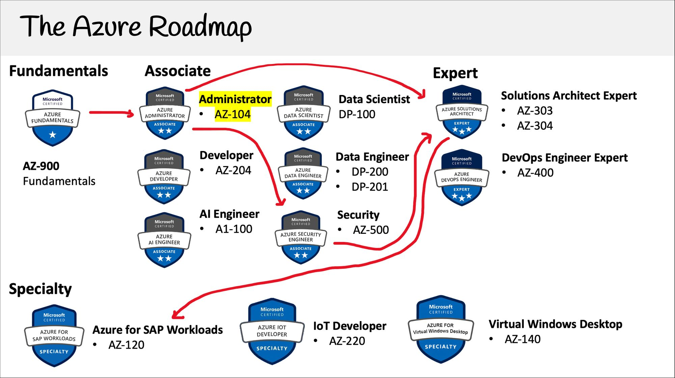


Not for distribution ⒸStelleCloud
www.stellecloud.com
www.corvit.com

Slide 3
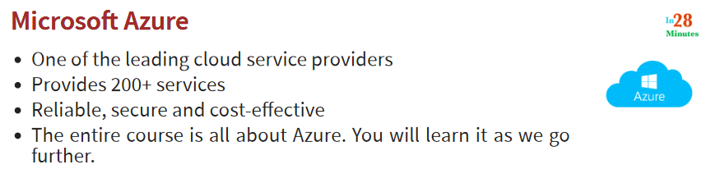
Not for distribution ⒸStelleCloud
www.stellecloud.com
www.corvit.com

Slide 4
Regions and Zones
Not for distribution ⒸStelleCloud
www.stellecloud.com
www.corvit.com

Slide 5
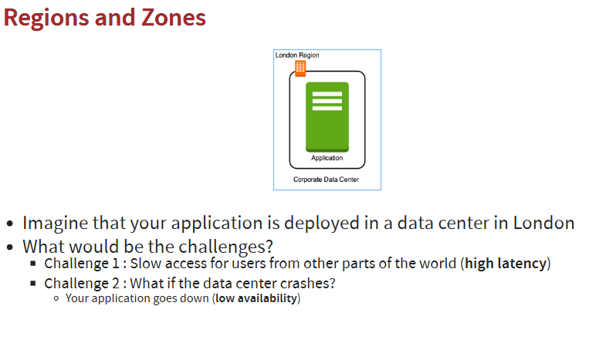
Not for distribution ⒸStelleCloud
www.stellecloud.com
www.corvit.com

Slide 6
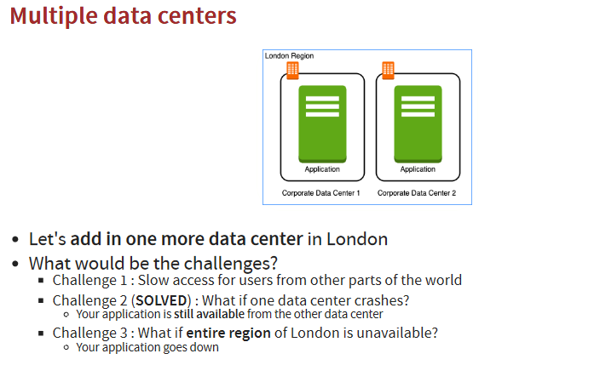
Not for distribution ⒸStelleCloud
www.stellecloud.com
www.corvit.com

Slide 7
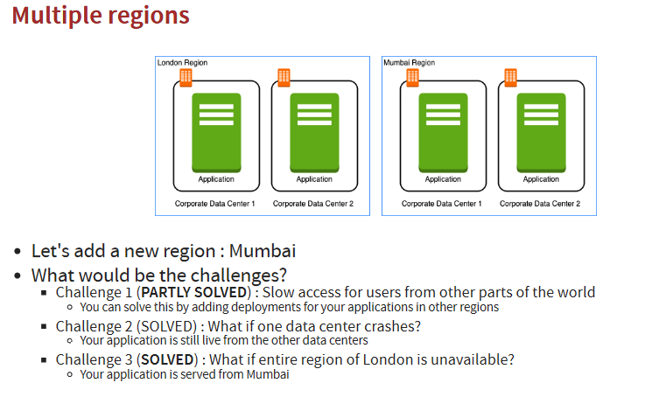
Not for distribution ⒸStelleCloud
www.stellecloud.com
www.corvit.com

Slide 8
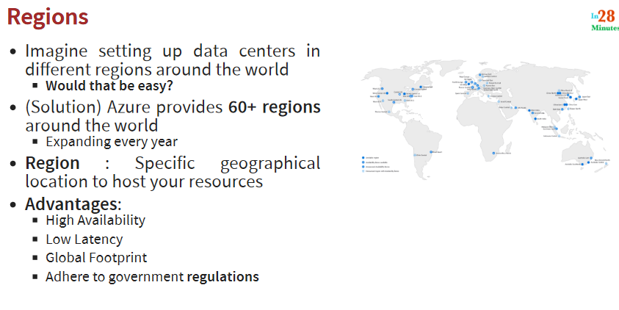
Not for distribution ⒸStelleCloud
www.stellecloud.com
www.corvit.com

Slide 9
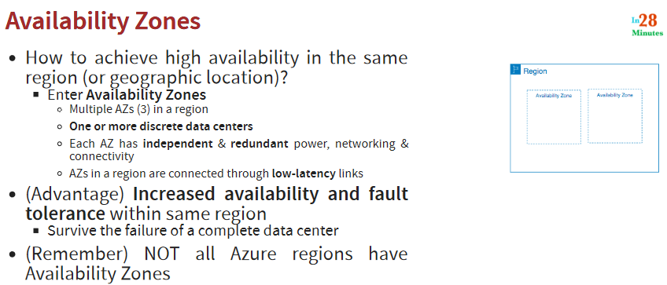
Not for distribution ⒸStelleCloud
www.stellecloud.com
www.corvit.com

Slide 10
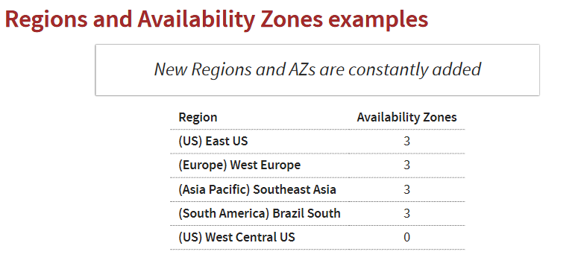
Not for distribution ⒸStelleCloud
www.stellecloud.com
www.corvit.com

Slide 11
Azure Virtual Machines
Not for distribution ⒸStelleCloud
www.stellecloud.com
www.corvit.com

Slide 12
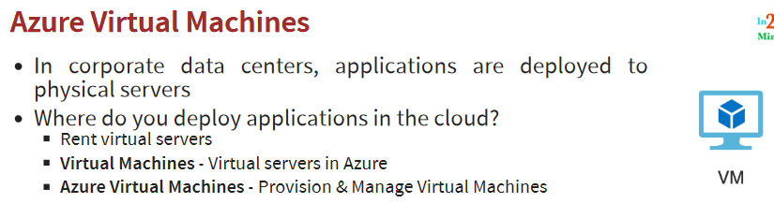
Not for distribution ⒸStelleCloud
www.stellecloud.com
www.corvit.com

Slide 13
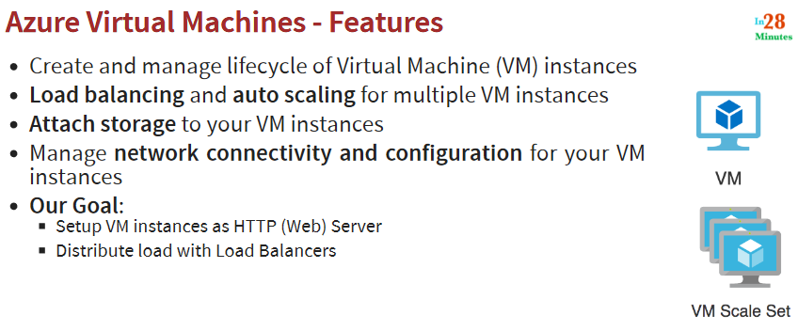
Not for distribution ⒸStelleCloud
www.stellecloud.com
www.corvit.com

Slide 14
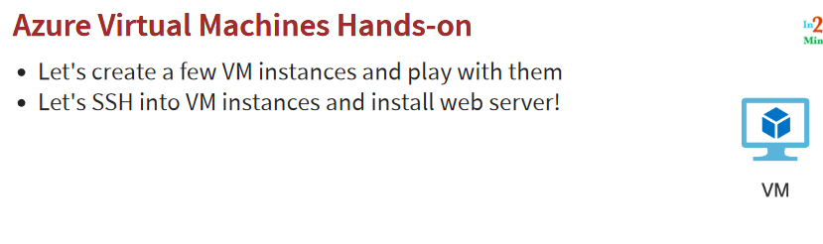
Not for distribution ⒸStelleCloud
www.stellecloud.com
www.corvit.com

Slide 15
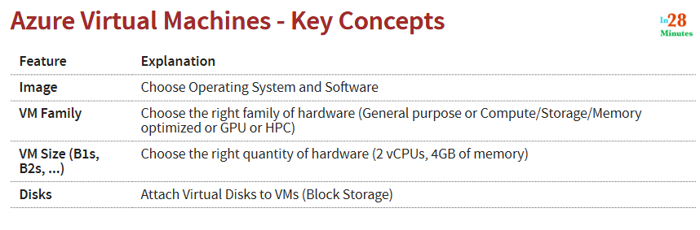
Not for distribution ⒸStelleCloud
www.stellecloud.com
www.corvit.com

Slide 16
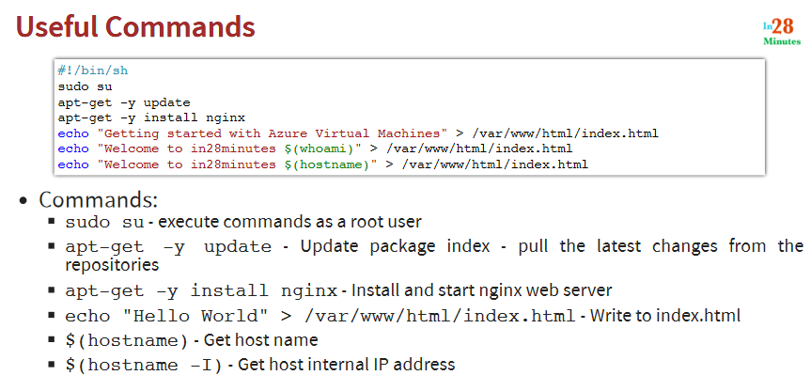
Not for distribution ⒸStelleCloud
www.stellecloud.com
www.corvit.com

Slide 17
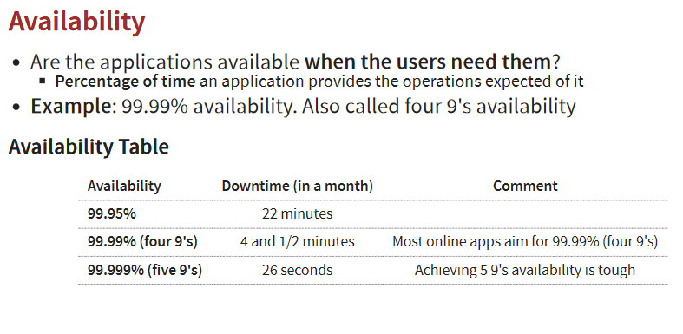
Not for distribution ⒸStelleCloud
www.stellecloud.com
www.corvit.com

Slide 18
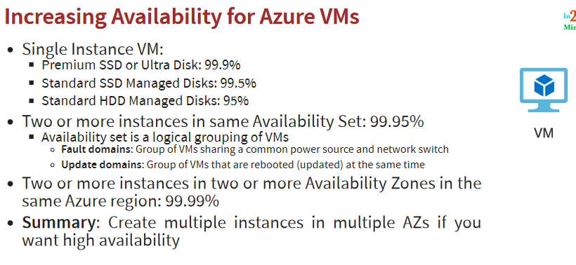
Not for distribution ⒸStelleCloud
www.stellecloud.com
www.corvit.com

Slide 19
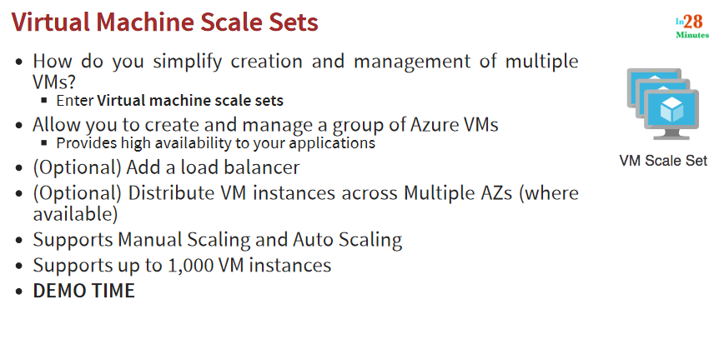
Not for distribution ⒸStelleCloud
www.stellecloud.com
www.corvit.com

Slide 20
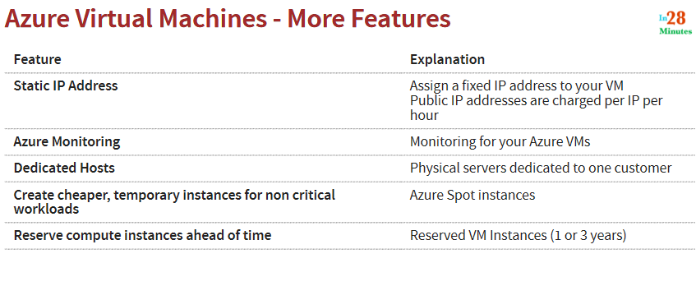
Not for distribution ⒸStelleCloud
www.stellecloud.com
www.corvit.com

Slide 21
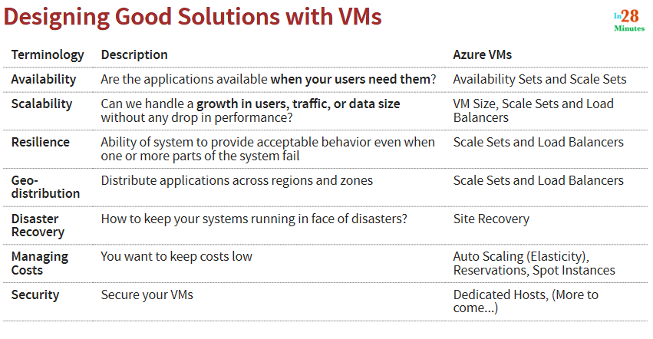
Not for distribution ⒸStelleCloud
www.stellecloud.com
www.corvit.com

Slide 22
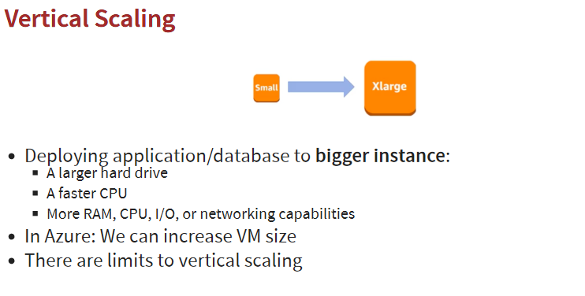
Not for distribution ⒸStelleCloud
www.stellecloud.com
www.corvit.com

Slide 23
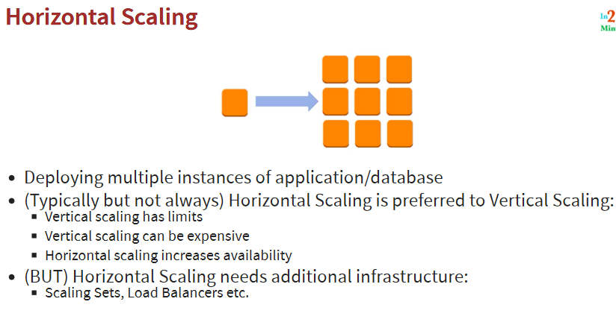
Not for distribution ⒸStelleCloud
www.stellecloud.com
www.corvit.com

Slide 24
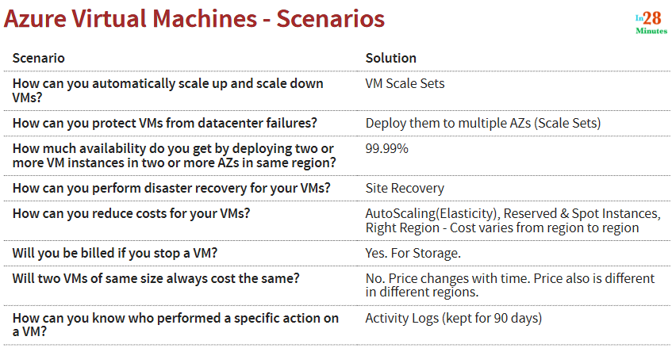
Not for distribution ⒸStelleCloud
www.stellecloud.com
www.corvit.com

Slide 25
Managed Services
Not for distribution ⒸStelleCloud
www.stellecloud.com
www.corvit.com

Slide 26
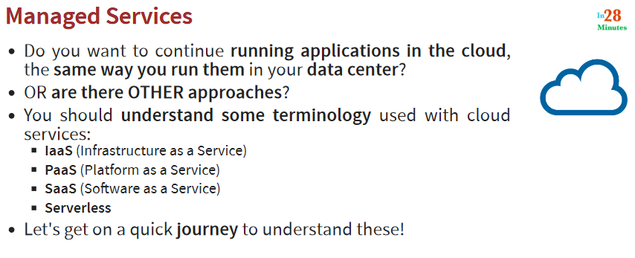
Not for distribution ⒸStelleCloud
www.stellecloud.com
www.corvit.com

Slide 27
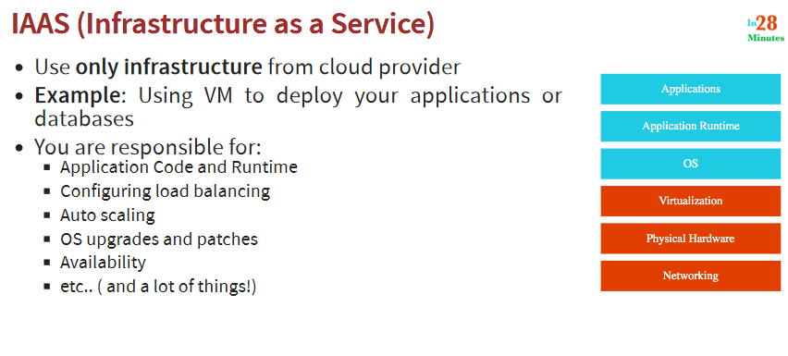
Not for distribution ⒸStelleCloud
www.stellecloud.com
www.corvit.com

Slide 28
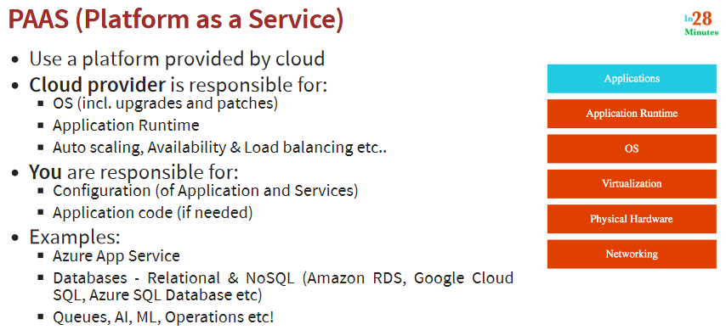
Not for distribution ⒸStelleCloud
www.stellecloud.com
www.corvit.com

Slide 29
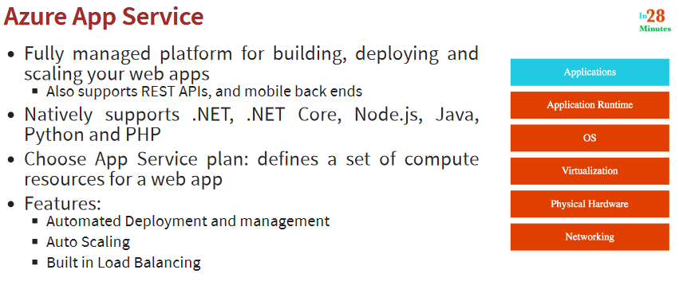
Not for distribution ⒸStelleCloud
www.stellecloud.com
www.corvit.com

Slide 30
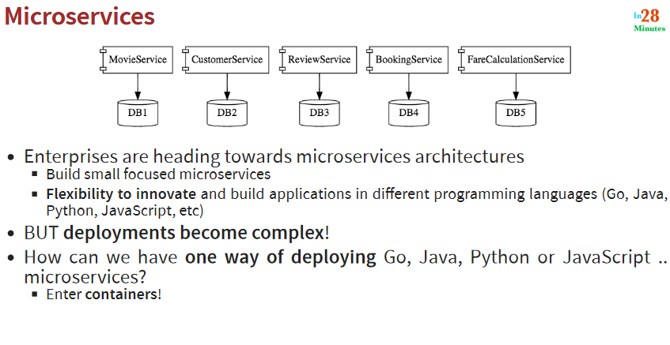
Not for distribution ⒸStelleCloud
www.stellecloud.com
www.corvit.com

Slide 31
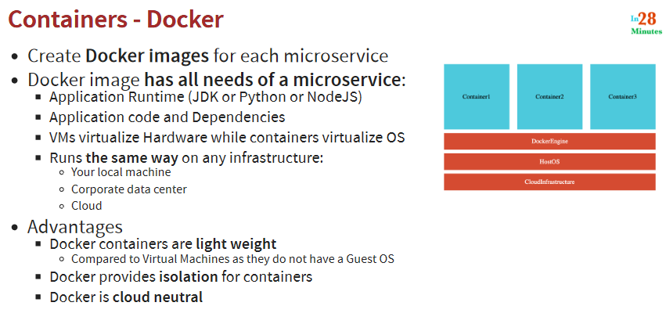
Not for distribution ⒸStelleCloud
www.stellecloud.com
www.corvit.com

Slide 32
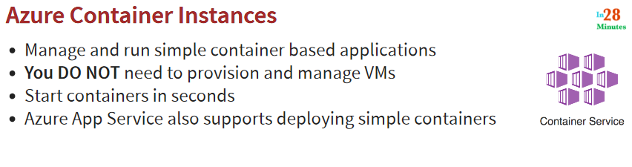
Not for distribution ⒸStelleCloud
www.stellecloud.com
www.corvit.com

Slide 33
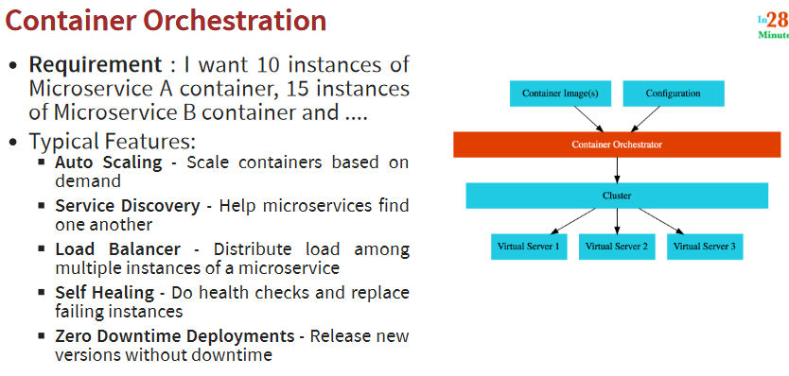
Not for distribution ⒸStelleCloud
www.stellecloud.com
www.corvit.com

Slide 34
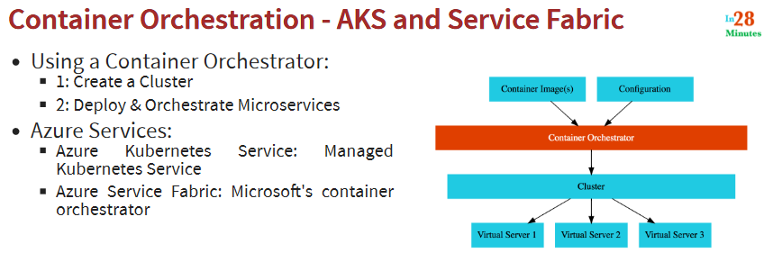
Not for distribution ⒸStelleCloud
www.stellecloud.com
www.corvit.com

Slide 35
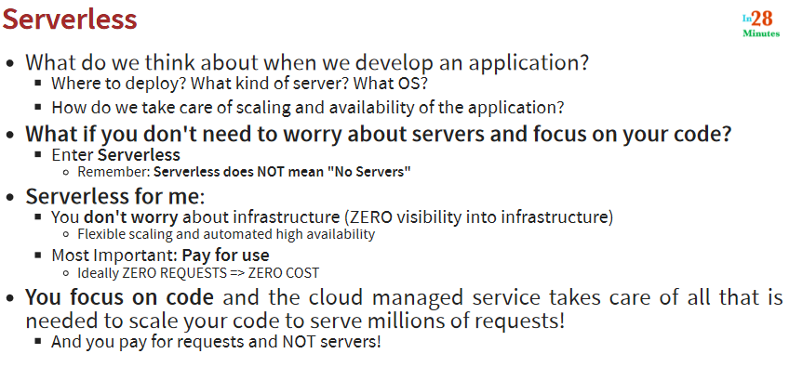
Not for distribution ⒸStelleCloud
www.stellecloud.com
www.corvit.com

Slide 36
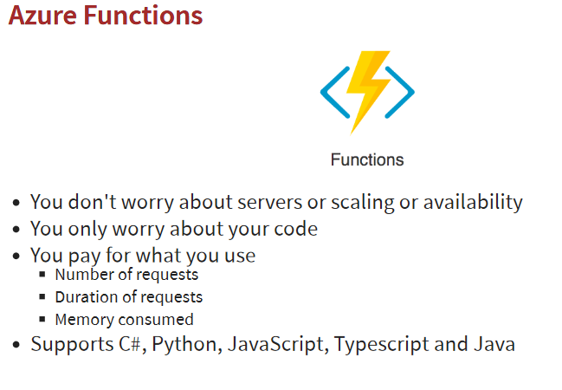
Not for distribution ⒸStelleCloud
www.stellecloud.com
www.corvit.com

Slide 37
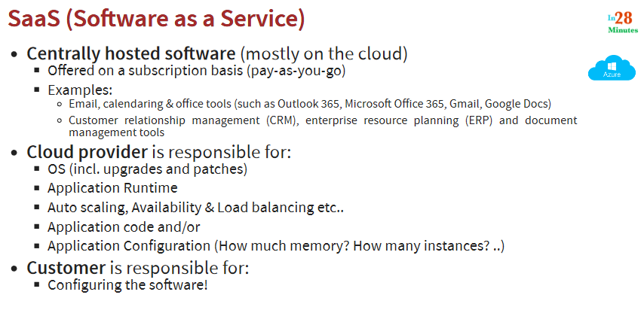
Not for distribution ⒸStelleCloud
www.stellecloud.com
www.corvit.com

Slide 38
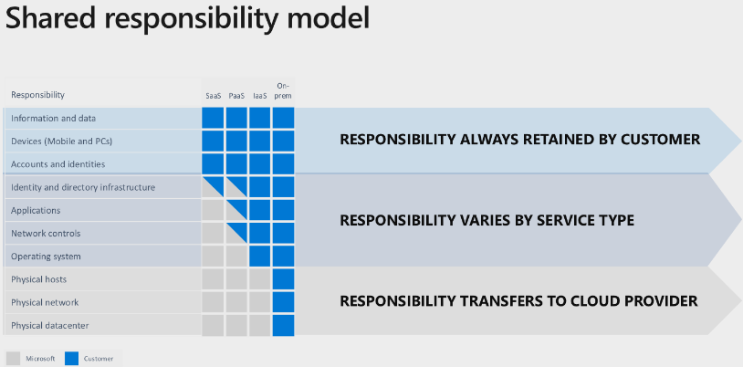
Not for distribution ⒸStelleCloud
www.stellecloud.com
www.corvit.com

Slide 39
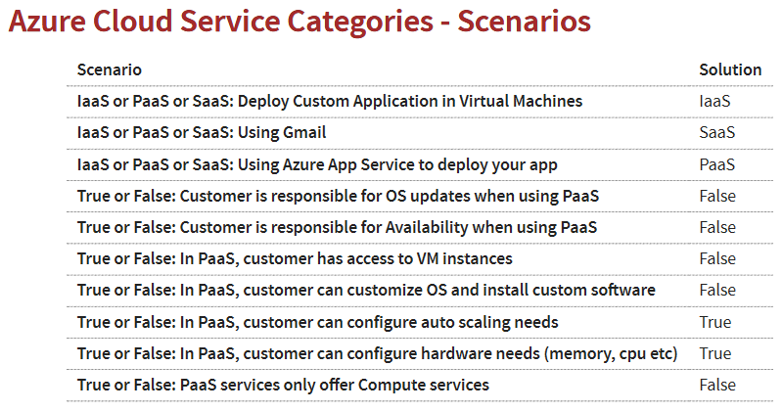
Not for distribution ⒸStelleCloud
www.stellecloud.com
www.corvit.com

Slide 40
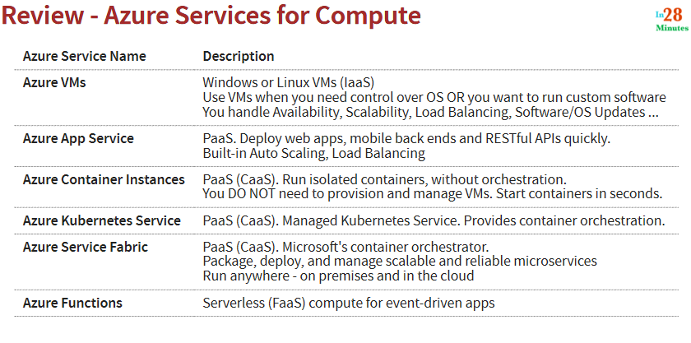
Not for distribution ⒸStelleCloud
www.stellecloud.com
www.corvit.com

Slide 41
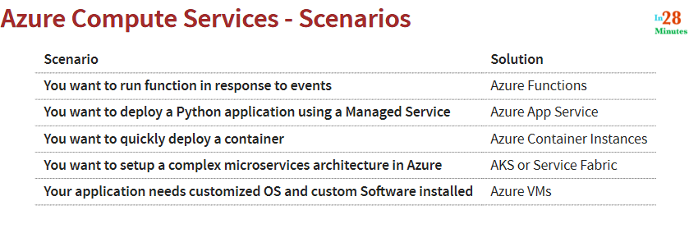
Not for distribution ⒸStelleCloud
www.stellecloud.com
www.corvit.com

Slide 42
Storage
Not for distribution ⒸStelleCloud
www.stellecloud.com
www.corvit.com

Slide 43
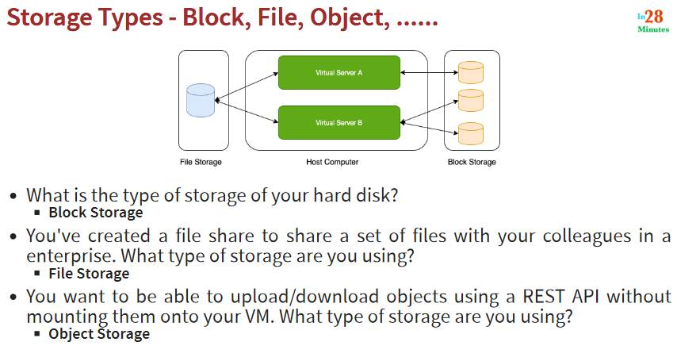
Not for distribution ⒸStelleCloud
www.stellecloud.com
www.corvit.com

Slide 44
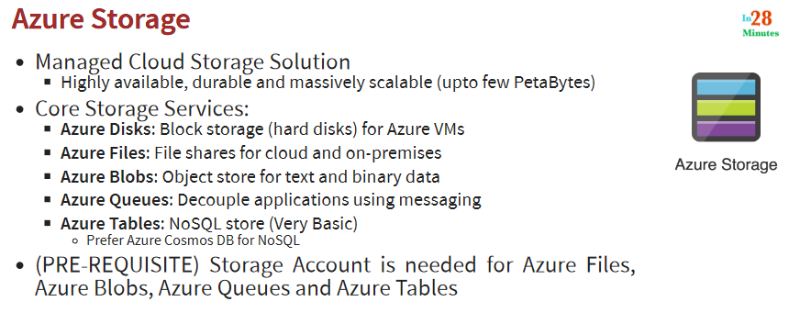
Not for distribution ⒸStelleCloud
www.stellecloud.com
www.corvit.com

Slide 45
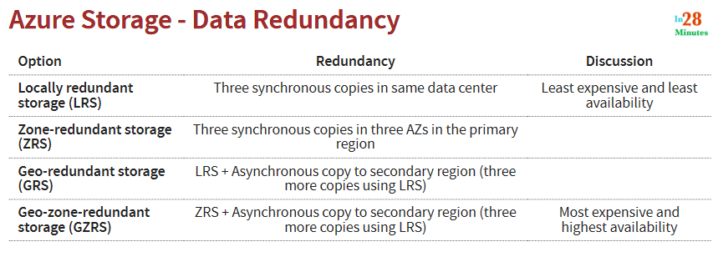
Not for distribution ⒸStelleCloud
www.stellecloud.com
www.corvit.com

Slide 46
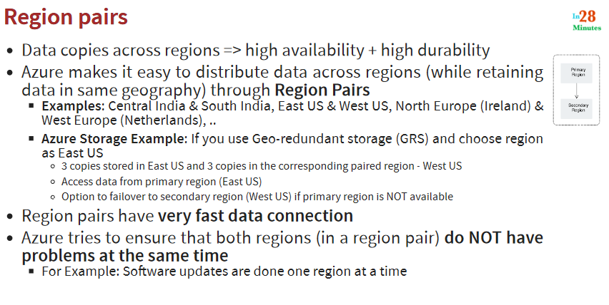
Not for distribution ⒸStelleCloud
www.stellecloud.com
www.corvit.com

Slide 47
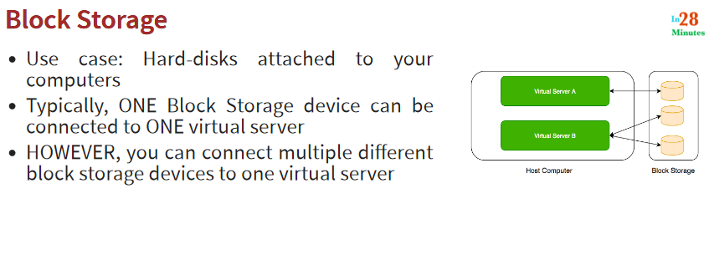
Not for distribution ⒸStelleCloud
www.stellecloud.com
www.corvit.com

Slide 48
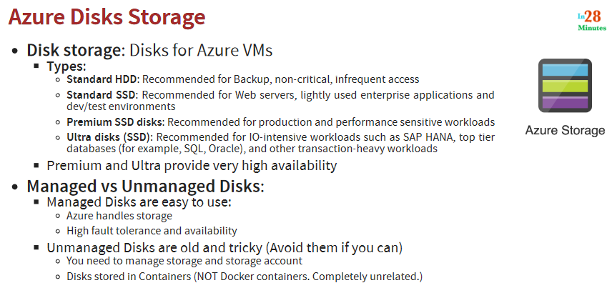
Not for distribution ⒸStelleCloud
www.stellecloud.com
www.corvit.com

Slide 49
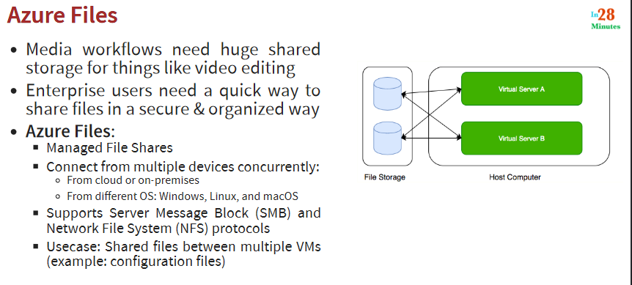
Not for distribution ⒸStelleCloud
www.stellecloud.com
www.corvit.com

Slide 50
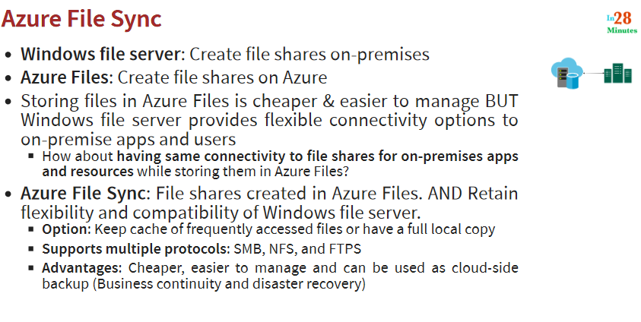
Not for distribution ⒸStelleCloud
www.stellecloud.com
www.corvit.com

Slide 51
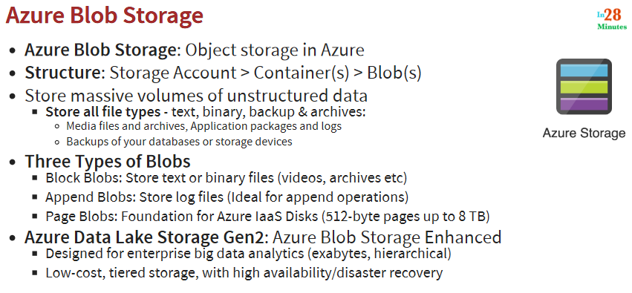
Not for distribution ⒸStelleCloud
www.stellecloud.com
www.corvit.com

Slide 52
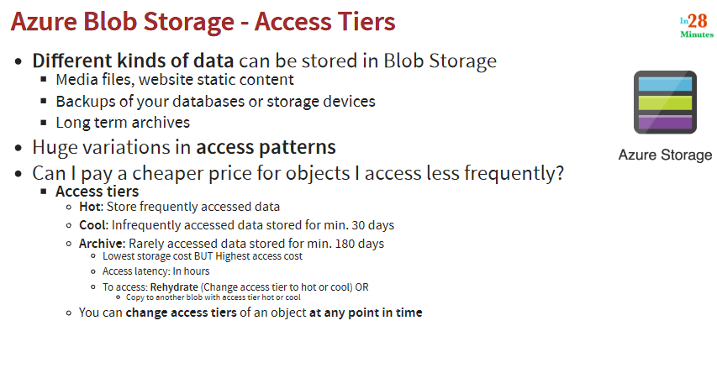
Not for distribution ⒸStelleCloud
www.stellecloud.com
www.corvit.com

Slide 53
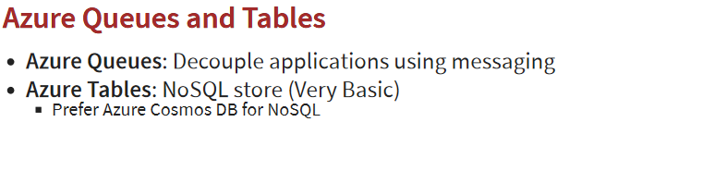
Not for distribution ⒸStelleCloud
www.stellecloud.com
www.corvit.com

Slide 54
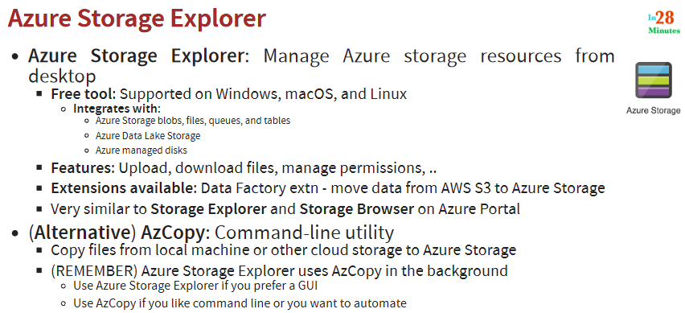
Not for distribution ⒸStelleCloud
www.stellecloud.com
www.corvit.com

Slide 55
Database Fundamentals
Not for distribution ⒸStelleCloud
www.stellecloud.com
www.corvit.com

Slide 56
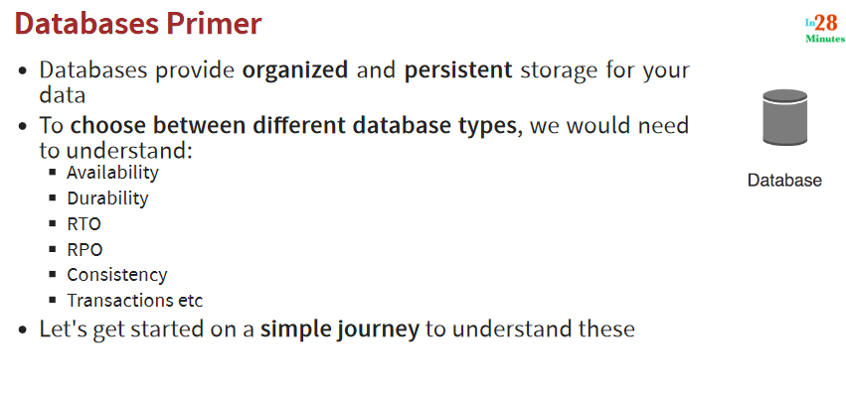
Not for distribution ⒸStelleCloud
www.stellecloud.com
www.corvit.com

Slide 57

Not for distribution ⒸStelleCloud
www.stellecloud.com
www.corvit.com

Slide 58

Not for distribution ⒸStelleCloud
www.stellecloud.com
www.corvit.com

Slide 59

Not for distribution ⒸStelleCloud
www.stellecloud.com
www.corvit.com

Slide 60

Not for distribution ⒸStelleCloud
www.stellecloud.com
www.corvit.com

Slide 61

Not for distribution ⒸStelleCloud
www.stellecloud.com
www.corvit.com

Slide 62

Not for distribution ⒸStelleCloud
www.stellecloud.com
www.corvit.com

Slide 63

Not for distribution ⒸStelleCloud
www.stellecloud.com
www.corvit.com

Slide 64

Not for distribution ⒸStelleCloud
www.stellecloud.com
www.corvit.com

Slide 65

Not for distribution ⒸStelleCloud
www.stellecloud.com
www.corvit.com

Slide 66

Not for distribution ⒸStelleCloud
www.stellecloud.com
www.corvit.com

Slide 67

Not for distribution ⒸStelleCloud
www.stellecloud.com
www.corvit.com

Slide 68

Not for distribution ⒸStelleCloud
www.stellecloud.com
www.corvit.com

Slide 69

Not for distribution ⒸStelleCloud
www.stellecloud.com
www.corvit.com

Slide 70

Not for distribution ⒸStelleCloud
www.stellecloud.com
www.corvit.com

Slide 71

Not for distribution ⒸStelleCloud
www.stellecloud.com
www.corvit.com

Slide 72

Relational Database – OLTP (Online Transaction Processing
Not for distribution ⒸStelleCloud
www.stellecloud.com
www.corvit.com

Slide 73

Not for distribution ⒸStelleCloud
www.stellecloud.com
www.corvit.com

Slide 74

Not for distribution ⒸStelleCloud
www.stellecloud.com
www.corvit.com

Slide 75

Not for distribution ⒸStelleCloud
www.stellecloud.com
www.corvit.com

Slide 76

Not for distribution ⒸStelleCloud
www.stellecloud.com
www.corvit.com

Slide 77

Not for distribution ⒸStelleCloud
www.stellecloud.com
www.corvit.com

Slide 78

Not for distribution ⒸStelleCloud
www.stellecloud.com
www.corvit.com

Slide 79

Not for distribution ⒸStelleCloud
www.stellecloud.com
www.corvit.com

Slide 80

Not for distribution ⒸStelleCloud
www.stellecloud.com
www.corvit.com

Slide 81

Not for distribution ⒸStelleCloud
www.stellecloud.com
www.corvit.com

Slide 82

Not for distribution ⒸStelleCloud
www.stellecloud.com
www.corvit.com

Slide 83
Networking
Not for distribution ⒸStelleCloud
www.stellecloud.com
www.corvit.com

Slide 84

Not for distribution ⒸStelleCloud
www.stellecloud.com
www.corvit.com

Slide 85

Not for distribution ⒸStelleCloud
www.stellecloud.com
www.corvit.com

Slide 86



Not for distribution ⒸStelleCloud
www.stellecloud.com
www.corvit.com

Slide 87

Not for distribution ⒸStelleCloud
www.stellecloud.com
www.corvit.com

Slide 88
Azure Network Security
Not for distribution ⒸStelleCloud
www.stellecloud.com
www.corvit.com

Slide 89

Not for distribution ⒸStelleCloud
www.stellecloud.com
www.corvit.com

Slide 90

Not for distribution ⒸStelleCloud
www.stellecloud.com
www.corvit.com

Slide 91

Not for distribution ⒸStelleCloud
www.stellecloud.com
www.corvit.com

Slide 92

Not for distribution ⒸStelleCloud
www.stellecloud.com
www.corvit.com

Slide 93

Not for distribution ⒸStelleCloud
www.stellecloud.com
www.corvit.com

Slide 94

Not for distribution ⒸStelleCloud
www.stellecloud.com
www.corvit.com

Slide 95

Not for distribution ⒸStelleCloud
www.stellecloud.com
www.corvit.com

Slide 96

Not for distribution ⒸStelleCloud
www.stellecloud.com
www.corvit.com

Slide 97

Not for distribution ⒸStelleCloud
www.stellecloud.com
www.corvit.com

Slide 98
Organizing and Managing Azure Resources
Not for distribution ⒸStelleCloud
www.stellecloud.com
www.corvit.com

Slide 99

Not for distribution ⒸStelleCloud
www.stellecloud.com
www.corvit.com

Slide 100

Not for distribution ⒸStelleCloud
www.stellecloud.com
www.corvit.com

Slide 101

Not for distribution ⒸStelleCloud
www.stellecloud.com
www.corvit.com

Slide 102

Not for distribution ⒸStelleCloud
www.stellecloud.com
www.corvit.com

Slide 103

Not for distribution ⒸStelleCloud
www.stellecloud.com
www.corvit.com

Slide 104
Azure Security Features
Not for distribution ⒸStelleCloud
www.stellecloud.com
www.corvit.com

Slide 105

Not for distribution ⒸStelleCloud
www.stellecloud.com
www.corvit.com

Slide 106

Not for distribution ⒸStelleCloud
www.stellecloud.com
www.corvit.com

Slide 107

Not for distribution ⒸStelleCloud
www.stellecloud.com
www.corvit.com

Slide 108
Core Azure Identity services
Not for distribution ⒸStelleCloud
www.stellecloud.com
www.corvit.com

Slide 109

Not for distribution ⒸStelleCloud
www.stellecloud.com
www.corvit.com

Slide 110

Not for distribution ⒸStelleCloud
www.stellecloud.com
www.corvit.com

Slide 111

Not for distribution ⒸStelleCloud
www.stellecloud.com
www.corvit.com

Slide 112

Not for distribution ⒸStelleCloud
www.stellecloud.com
www.corvit.com

Slide 113

Not for distribution ⒸStelleCloud
www.stellecloud.com
www.corvit.com

Slide 114

Not for distribution ⒸStelleCloud
www.stellecloud.com
www.corvit.com

Slide 115

Not for distribution ⒸStelleCloud
www.stellecloud.com
www.corvit.com

Slide 116

Not for distribution ⒸStelleCloud
www.stellecloud.com
www.corvit.com

Slide 117

Not for distribution ⒸStelleCloud
www.stellecloud.com
www.corvit.com

Slide 118
Azure Management Resources
Not for distribution ⒸStelleCloud
www.stellecloud.com
www.corvit.com

Slide 119

Not for distribution ⒸStelleCloud
www.stellecloud.com
www.corvit.com

Slide 120

Not for distribution ⒸStelleCloud
www.stellecloud.com
www.corvit.com

Slide 121

Not for distribution ⒸStelleCloud
www.stellecloud.com
www.corvit.com

Slide 122

Not for distribution ⒸStelleCloud
www.stellecloud.com
www.corvit.com

Slide 123

Not for distribution ⒸStelleCloud
www.stellecloud.com
www.corvit.com

Slide 124

Not for distribution ⒸStelleCloud
www.stellecloud.com
www.corvit.com

Slide 125

Not for distribution ⒸStelleCloud
www.stellecloud.com
www.corvit.com

Slide 126
Azure Governance Features
Not for distribution ⒸStelleCloud
www.stellecloud.com
www.corvit.com

Slide 127

Not for distribution ⒸStelleCloud
www.stellecloud.com
www.corvit.com

Slide 128

Not for distribution ⒸStelleCloud
www.stellecloud.com
www.corvit.com

Slide 129

Not for distribution ⒸStelleCloud
www.stellecloud.com
www.corvit.com

Slide 130

Not for distribution ⒸStelleCloud
www.stellecloud.com
www.corvit.com

Slide 131

Not for distribution ⒸStelleCloud
www.stellecloud.com
www.corvit.com

Slide 132
Privacy and Compliance
Not for distribution ⒸStelleCloud
www.stellecloud.com
www.corvit.com

Slide 133

Not for distribution ⒸStelleCloud
www.stellecloud.com
www.corvit.com

Slide 134

Not for distribution ⒸStelleCloud
www.stellecloud.com
www.corvit.com

Slide 135

Not for distribution ⒸStelleCloud
www.stellecloud.com
www.corvit.com

Slide 136

Not for distribution ⒸStelleCloud
www.stellecloud.com
www.corvit.com

Slide 137

Not for distribution ⒸStelleCloud
www.stellecloud.com
www.corvit.com

Slide 138
Azure cost management – planning and managing costs
Not for distribution ⒸStelleCloud
www.stellecloud.com
www.corvit.com

Slide 139

Not for distribution ⒸStelleCloud
www.stellecloud.com
www.corvit.com

Slide 140

Not for distribution ⒸStelleCloud
www.stellecloud.com
www.corvit.com

Slide 141

Not for distribution ⒸStelleCloud
www.stellecloud.com
www.corvit.com

Slide 142

Not for distribution ⒸStelleCloud
www.stellecloud.com
www.corvit.com

Slide 143

Not for distribution ⒸStelleCloud
www.stellecloud.com
www.corvit.com

Slide 144

Not for distribution ⒸStelleCloud
www.stellecloud.com
www.corvit.com

Slide 145

Not for distribution ⒸStelleCloud
www.stellecloud.com
www.corvit.com

Slide 146
More Azure
Not for distribution ⒸStelleCloud
www.stellecloud.com
www.corvit.com

Slide 147

Not for distribution ⒸStelleCloud
www.stellecloud.com
www.corvit.com

Slide 148

Not for distribution ⒸStelleCloud
www.stellecloud.com
www.corvit.com

Slide 149

Not for distribution ⒸStelleCloud
www.stellecloud.com
www.corvit.com

Slide 150

Not for distribution ⒸStelleCloud
www.stellecloud.com
www.corvit.com

Slide 151
DevOps
Not for distribution ⒸStelleCloud
www.stellecloud.com
www.corvit.com

Slide 152


Not for distribution ⒸStelleCloud
www.stellecloud.com
www.corvit.com

Slide 153

Not for distribution ⒸStelleCloud
www.stellecloud.com
www.corvit.com

Slide 154

Not for distribution ⒸStelleCloud
www.stellecloud.com
www.corvit.com

Slide 155

Not for distribution ⒸStelleCloud
www.stellecloud.com
www.corvit.com

Slide 156

Not for distribution ⒸStelleCloud
www.stellecloud.com
www.corvit.com

Slide 157

Not for distribution ⒸStelleCloud
www.stellecloud.com
www.corvit.com

Slide 158

Not for distribution ⒸStelleCloud
www.stellecloud.com
www.corvit.com

Slide 159

Not for distribution ⒸStelleCloud
www.stellecloud.com
www.corvit.com

Slide 160

Not for distribution ⒸStelleCloud
www.stellecloud.com
www.corvit.com

Slide 161

Not for distribution ⒸStelleCloud
www.stellecloud.com
www.corvit.com

Slide 162
Quick Review
Not for distribution ⒸStelleCloud
www.stellecloud.com
www.corvit.com

Slide 163

Not for distribution ⒸStelleCloud
www.stellecloud.com
www.corvit.com

Slide 164

Not for distribution ⒸStelleCloud
www.stellecloud.com
www.corvit.com

Slide 165

Not for distribution ⒸStelleCloud
www.stellecloud.com
www.corvit.com

Slide 166

Not for distribution ⒸStelleCloud
www.stellecloud.com
www.corvit.com

Slide 167
Get ready for your Certification
Not for distribution ⒸStelleCloud
www.stellecloud.com
www.corvit.com

Slide 168

Not for distribution ⒸStelleCloud
www.stellecloud.com
www.corvit.com

